Slide 1
R Programming (CSW318B)
#Workshop: 1
Manav Rachna University, Faridabad

Slide 2
What is Analytics?
Analytics is the systematic computational analysis of data or statistics.
It is used for the discovery, interpretation, and communication of meaningful patterns in data.
It also entails applying data patterns towards effective decision making

Slide 3
Why do we need Analytics?
Cost Reduction
Better marketing
Product Analysis
Organization Analysis
Fast
Better Decision Making

Slide 4
Business Analytics
Study of business data using statistical techniques and programming for creating decision support and insights for achieving business goals.
Business Analytics solutions typically use statistical and quantitative analysis and fact-based data to measure past performance to guide organization’s business planning.
Business analytics is used to evaluate organization-wide operations, and can be implemented in any department from sales to product development to customer service.

Slide 5
Introduction to R
R is an open source programming language and software environment for statistical computing and graphics.
The R language is widely used among statisticians and data miners for developing statistical software and data analytics tools

Slide 6
History of R
R was initially written by Ross Ihaka and Robert Gentleman at the Department of Statistics of the University of Auckland in Auckland, New Zealand. R made its first appearance in 1993.
A large group of individuals has contributed to R by sending code and bug reports.
Since mid-1997 there has been a core group (the "R Core Team") who can modify the R source code archive.

Slide 7
Why R?
It's free!
It runs on a variety of platforms including Windows, Unix and MacOS.
It provides an unparalleled platform for programming new statistical methods in an easy and straightforward manner.
It contains advanced statistical routines not yet available in other packages.
It has state-of-the-art graphics capabilities.

Slide 8
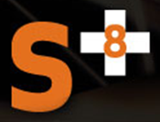

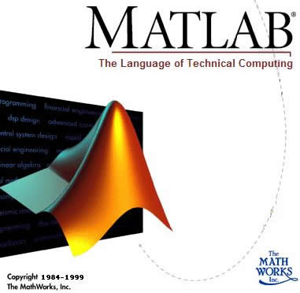


Why R?
Statistics & Data Mining
Commercial
Technical computing
Matrix and vector formulations
Statistical computing and graphics
http://www.r-project.org
Data Visualization and analysis platform
Image processing, vector computing
Developed by R. Gentleman & R. Ihaka
Expanded by community as open source
Statistically rich
Notes:
8
Do the head count of who uses each tool routinely or more preferentially.
There are other commercial software: S-PLUS, SAS
Much limited data mining tools: Weka, DAP, gretl
Matlab – for matrices
IDL – for visualization
R – for statistics, and open, extensible, large community
------------------------------------------
Other Open Source Projects:
Dap, gretl, Weka
Other Proprietary Projects:
IDL, Matlab, Mathematica
Dap: a small statistics and graphics package based on C. Anyone familiar with the basic syntax of C programs can learn to use the C-style features of Dap quickly and easily; advanced features of C are not necessary, although they are available.
Gretl: Gnu Regression, Econometrics and Time-series Library. for econometric analysis
Weka: a collection of machine learning algorithms for data mining tasks.

Slide 9
The Dilemma of Programmer
What programming language to use & why?
Productivity
Performance
High-
Scripting
(R, MATLAB, IDL)
Level
Languages
Object Oriented
(C++, Java)
Functional languages
(C, Fortran)
Low-Level Languages
Assembly
Notes:
Low level languages can yield good performance, but often the productivity suffers. In contrast, high-level languages can offer good productivity, at the expense of performance.
Since many scientists use scripting environments, such as R, MATLAB and IDL, pR strives to bring the performance of low-level languages into high-level languages, specifically R, by enabling third-party compiled routines to execute transparently within R.
Examples of parallel third-party libraries: ScaLAPACK, PETSc
9

Slide 10
Features of R
The following are the important features of R:
R is a well-developed, simple and effective programming language which includes conditionals, loops, user defined recursive functions and input and output facilities.
R has an effective data handling and storage facility,
R provides a suite of operators for calculations on arrays, lists, vectors and matrices.
R provides a large, coherent and integrated collection of tools for data analysis.
R provides graphical facilities for data analysis and display either directly at the computer or printing at the papers.

Slide 11
Basic usage: arithmetic in R
You can use R as a calculator
Typed expressions will be evaluated and printed out
Main operations: +, -, *, /, ^
Obeys order of operations
Use parentheses to group expressions
More complex operations appear as functions
sqrt(2)
sin(pi/4), cos(pi/4), tan(pi/4), asin(1), acos(1), atan(1)
exp(1), log(2), log10(10)

Slide 12
Resources for R
http://www.r-project.org/
http://cran.r-project.org/doc/contrib/Verzani-SimpleR.pdf

Slide 13
Download R and RStudio
Download R :
http://cran.r-project.org/bin/
Download RStudio :
http://www.rstudio.com/ide/download/desktop

Slide 14
Installation
Installing R on windows PC :
Use internet browser to point to : http://mirror.aarnet.edu.au/pub/CRAN
Under the heading Precompiled Binary Distributions, choose the link Windows.
Next heading is R for Windows; choose the link base.
Click on download option(R 3.4.1 for windows).
Save this to the folder C:\R on your PC.
When downloading is complete, close or minimize the Internet browser.
Double click on R 3.4.1-win32.exe in C:\R to install.
Installing R on Linux:
sudo apt-get install r-base-core

Slide 15
Installation
Installing RStudio:
Go to www.rstudio.com and click on the "Download RStudio" button.
Click on "Download RStudio Desktop.“
Click on the version recommended for your system, or the latest Windows version, and save the executable file. Run the .exe file and follow the installation instructions.
For reference:
https://www.youtube.com/watch?v=NZxSA80lF1I

Slide 16
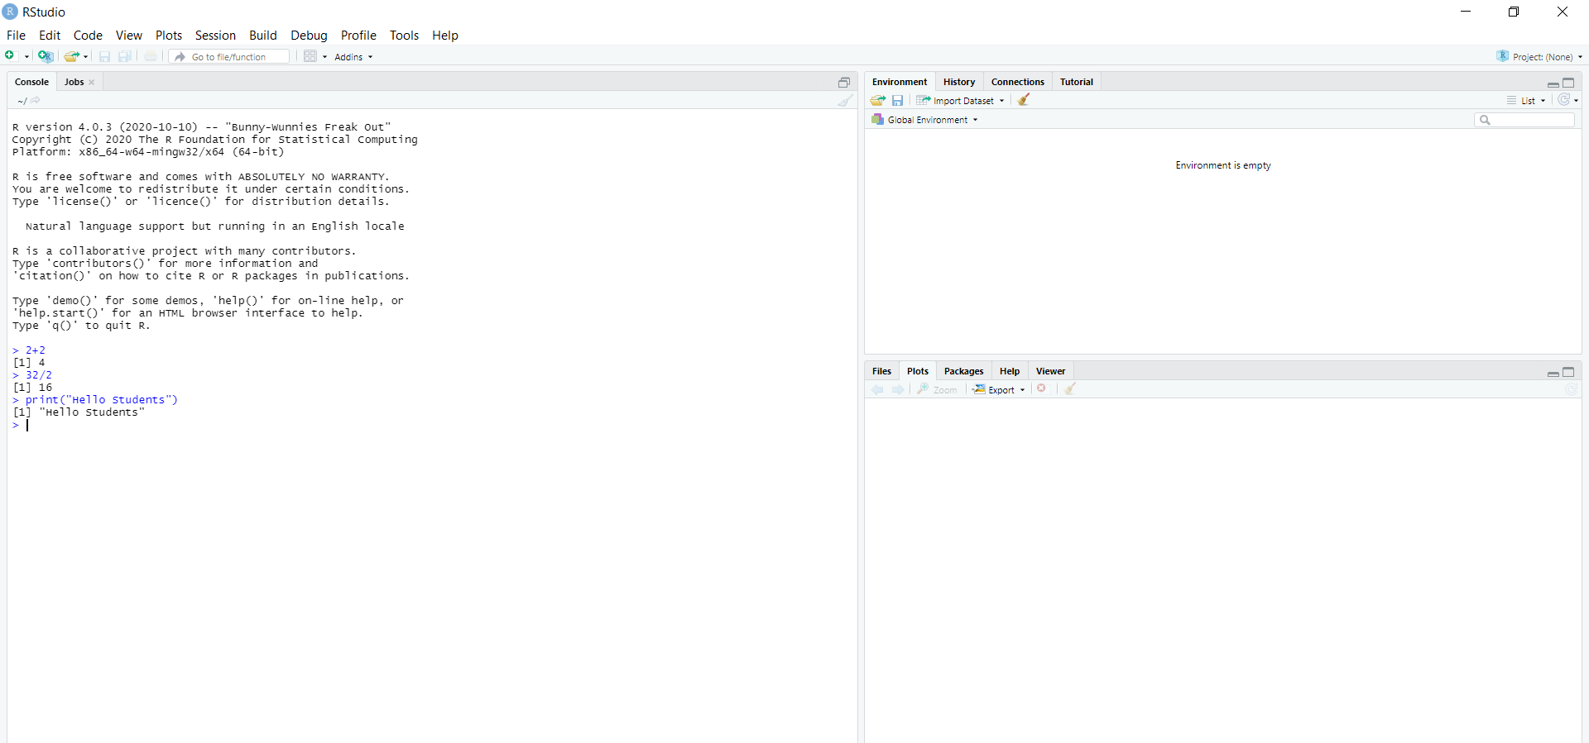
R studio

Slide 17
R Script File
Usually, you will do your programming by writing your programs in script files and then you execute those scripts at your R studio with the help of RUN command. So let's start with writing following code in a text file called test1.R as under:
# My first program in R Programming
print ( “Hello Students”)
Solution: Hello Students

Slide 18
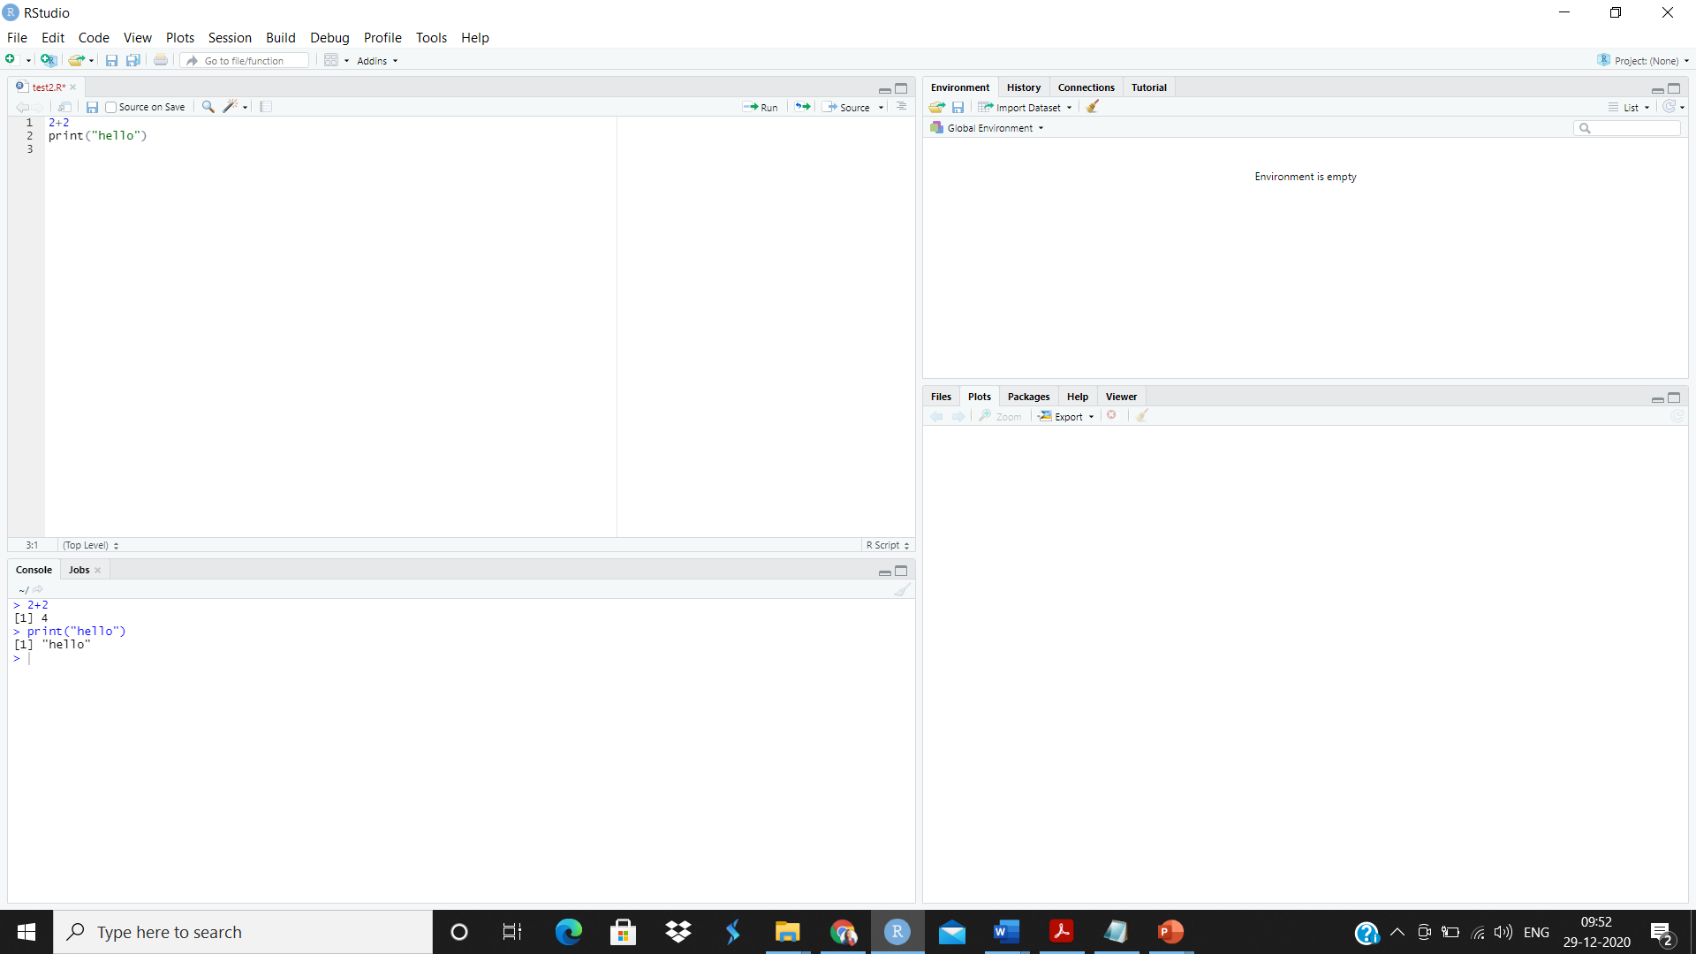
Save simple program file in R

Slide 19
Useful R links
R Home: http://www.r-project.org/
R’s CRAN package distribution: http://cran.cnr.berkeley.edu/
Introduction to R manual: http://cran.cnr.berkeley.edu/doc/manuals/R-intro.pdf
Writing R extensions: http://cran.cnr.berkeley.edu/doc/manuals/R-exts.pdf
Other R documentation: http://cran.cnr.berkeley.edu/manuals.html

